Slide 1



An Innovative Student-Engaged Sustainability & Utilities Reduction Program at the University of Guelph
Paul Mesman
Manager, Construction Coordination
Design, Engineering and Construction
Simon van Wonderen
Associate, National Manager of Client Services & Project Development

Slide 2




LEARNING
OBJECTIVES
Apply techniques and strategies to engage a campus community on innovative sustainability initiatives
Identify the high level energy and water use needs of large institutional facilities, using a systematic approach
Organize and implement water and energy study measures including large-scale thermal energy storage
Analyze financial models that can be applied to large-scale energy project

Slide 3
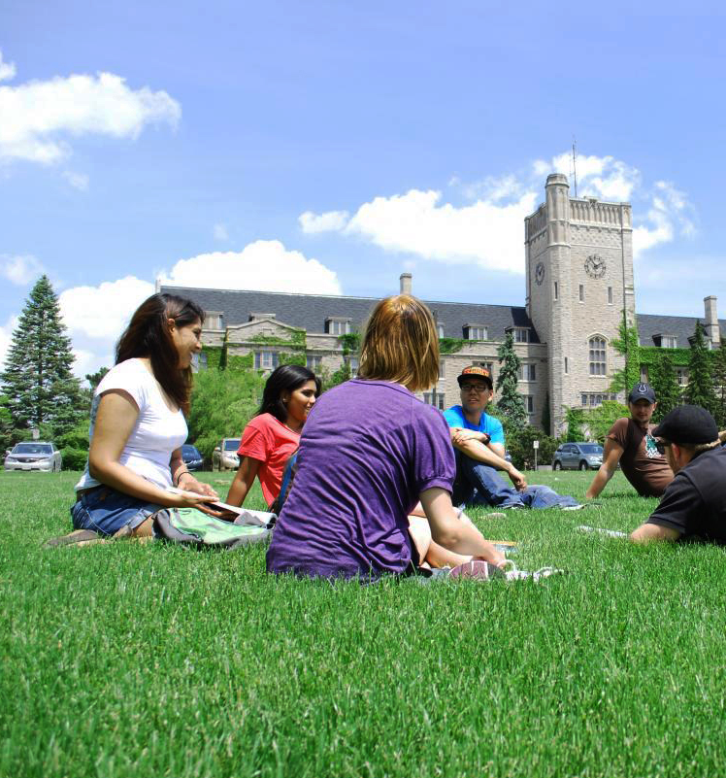




20,000
Full Time Students
148
Buildings
6.6M ft²

Slide 4

$22,000,000
ANNUAL UTILITY SPEND
$1,100
PER STUDENT

Slide 5
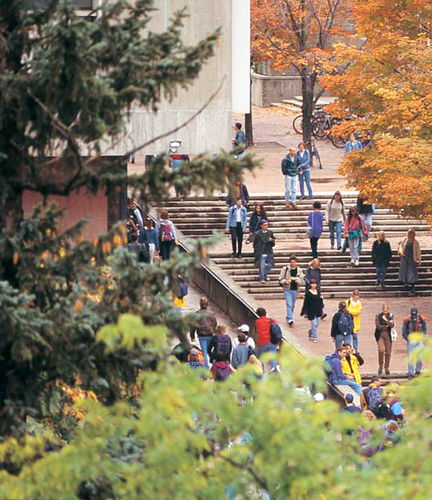
2006 Grassroots Student Movement Led to the Formation of the Student Energy Retrofit Fund and the Energy Conservation Working Group

Slide 6

ENERGY
PERFORMANCE
CONTRACT
What is it???
Agreement between a building owner and an Energy Service Company (ESCO)
How is it financed???
By energy savings achieved through the program
How is it guaranteed???
ESCO assumes risk

Slide 7
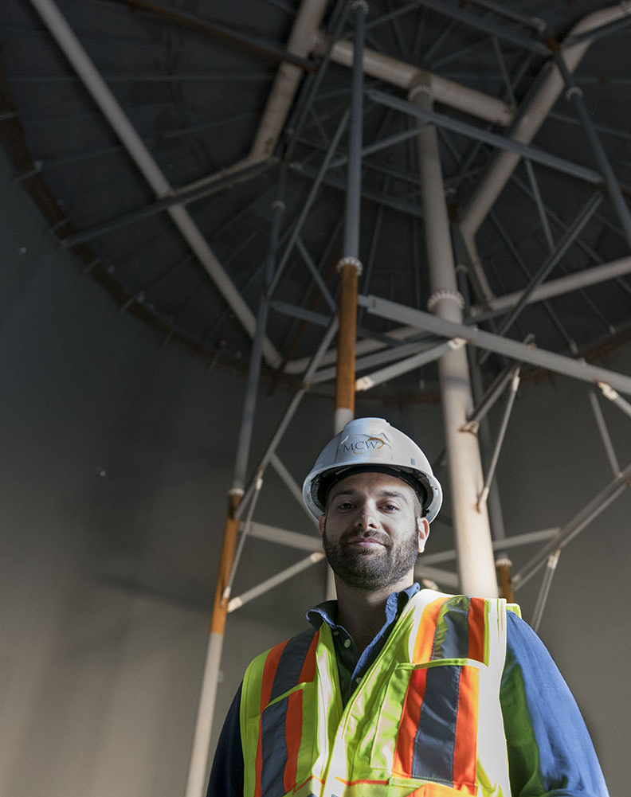
Large Scale Lighting Improvements
Heating and Cooling System Upgrades
Water Savings Measures
Demand Reduction Thermal Energy Storage
Community Awareness

Slide 8
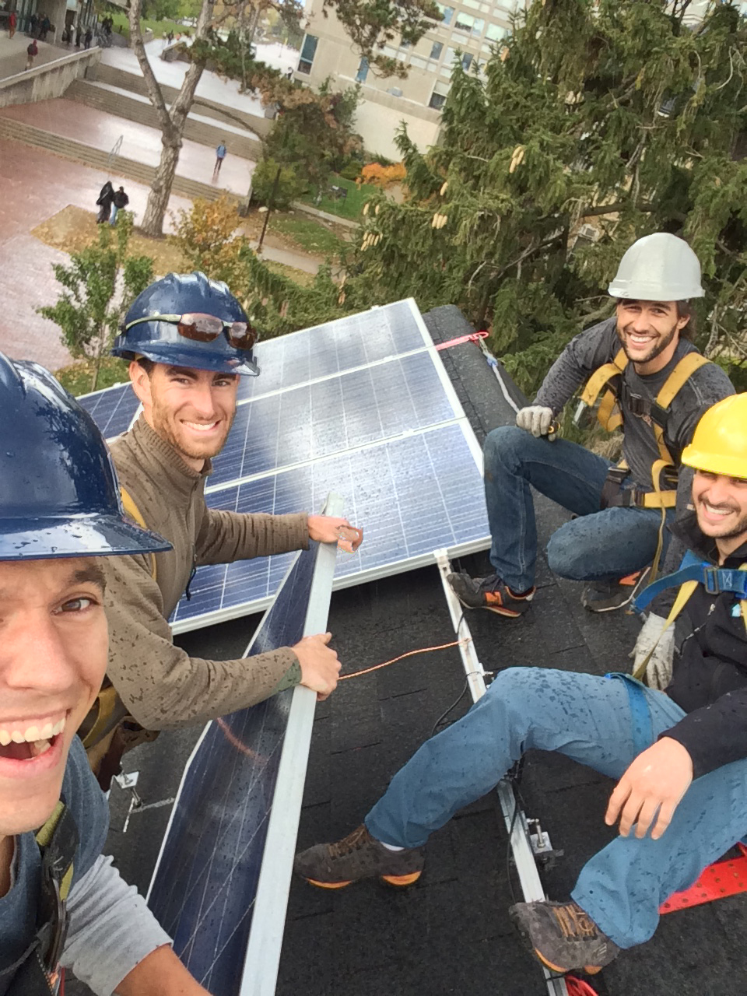
The Green Gryphon Initiative
$26.2M Plan
Save $2.5M Annually
Reduce GHG Emissions by 4,700 tonnes eCO₂
Maximize Incentive $
8 Year Simple Payback
Notes:
Paul has done a great job speaking of the EPC solution from the Owner’s perspective. In terms of their requirements for an energy project and how they went about getting it started.
I’d like to now speak about the development of that EPC solution - some of the considerations and challenges that were encountered and overcome – and how ultimately the metrics that are shown here came to be developed. In other words how did we as the Energy Service Company work with the U to come to develop and deliver a program with $2.5M annual savings.

Slide 9
Delivering an EPC Solution
EPC Solution…
Similar to Other University Energy Conservation Projects
Notes:
So let’s talk about the EPC process and I’ll start by recognizing that an EPC solution has a cycle similar to any other project that your U may run – starts by defining the project goals or criteria, teams get assigned, work gets planned, work happens, and the project is closed. Simple right?
In the case of your Energy project - the goals naturally focus on savings electricity, gas or water or reducing emissions. – the team is normally the from the physical resources department or sustainability side, with maybe some help from outside consultants - and I think it’s safe to say that funding for those projects often compete with redevelopment ambitions.
These types of projects are happening at most U’s here today and no doubt have success.

Slide 10
Delivering an EPC Solution
Project
Criteria
Additional Opportunities…
Scale
Expertise
Turn-Key Delivery
Program
Development
Approvals
and “GO”
Budget,
Financing and
Agreement
Collaboration
& Decision
Matrix
Notes:
Now imagine your institution identifies the need to go further – that last year’s reductions aren’t enough.
Most institutions recognize the tipping point at which they can no longer adequately support a self performed energy project of a certain scale – either from a resource, risk or funding standpoint.
One option, and the one we’re focused on here today, is the EPC solution. An ESCo partner brings dedicated project resources - 1) to enable further reaching energy measures on a campus wide scale, 2) offload risk performance from the Owner, and 3) and financing options.
The result is a project that is afforded additional scale, depth and diversity… and… ultimately savings that may not otherwise be achieved by the U were it self performed.

Slide 11



Delivering an EPC Solution
MANAGING ENERGY
ASSETS & LOADS
Scale
Expertise
Performance Guarantee
Financing
ENERGY
EFFICIENCY
ENERGY CONSERVATION
Notes:
To understand the tipping point of scale, technology and risk that may lend itself to an EPC it’s instructive to look at the basic energy savings pyramid that most of us have seen.
Let’s use the example of lighting technology for the purpose of the discussion.
At the most basic level, energy conservation – turning off the lights
Next level of opportunity is efficiently gains.,
Finally, at the top of the pyramid may be sophisticated schemes that manage lighting in combination with other assets, for demand leveling.
Of course risk and scale vary with position on the pyramid. Each institution may have their own tipping point at which scale, expertise, or funding becomes too difficult and the saving can either be left on the table or achieved with an EPC.
I’ll challenge you to think about where this tipping point may apply to your institution, and for which technology.

Slide 12
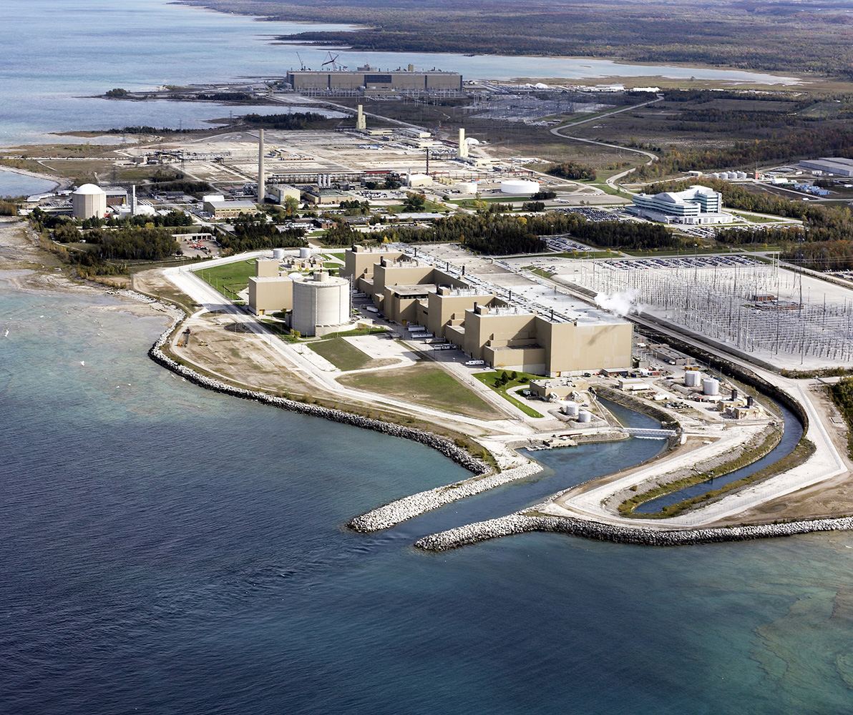

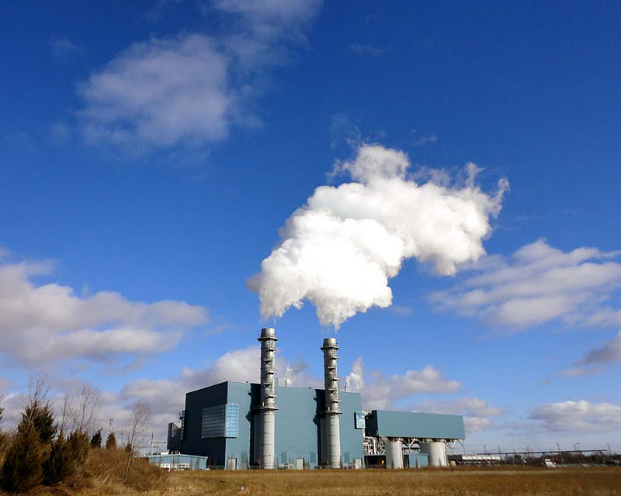
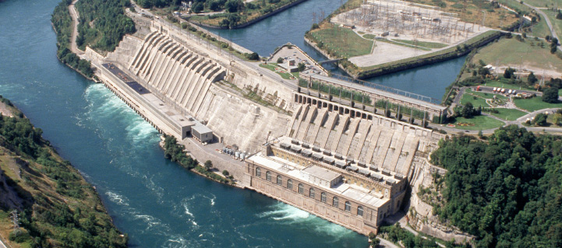
ONTARIO IS NOW UNDER A NEW ENERGY REGIME
Notes:
So let’s bring the discussion back to the UofG and the GGI.
Early in the EPC process the U recognized two important challenges - the need to achieve higher savings above and beyond what they had historically achieved – and - they also recognize a changing energy market, particularly with regards to Ontario’s electrical utility.
Disruptions such as the elimination of coal, expensive renewable energy contracts to replace the coal, even more expensive gas peaking plants to level the renewables, and the anticipation of the decommissioning of nuclear assets and pending Carbon Tax regime all meant new market pressures that a ‘business as usual’ approach not an option.

Slide 13
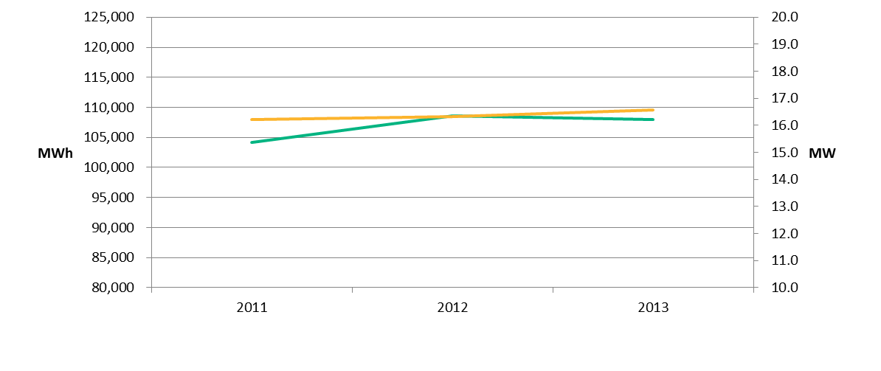
Program Development
Recognizing Opportunities
Demand (MW) & Consumption (MWh)
Annual
MW
MWh
Notes:
To give an example of this, let’s look at what the U’s electrical utility profile looked like in the years prior to the project.
MWh consumption – flat.
MW demand – flat.
Meanwhile campus is growing and building services are being added.
So the U was doing pretty good by this graph and they felt good about the savings (or avoidance).

Slide 14
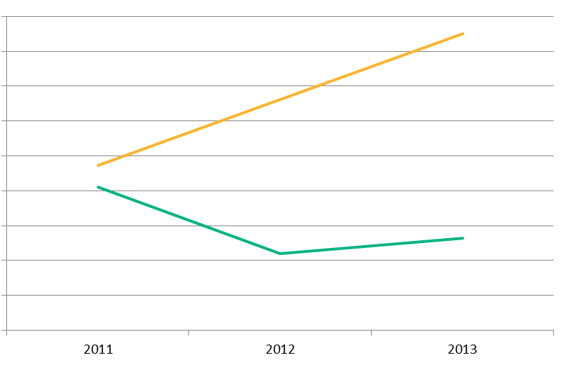
Program Development
Recognizing Opportunities
Demand – GA Charge
Utility Spend ($)
Annual
$6.0M
$5.5M
$5.0M
$4.5M
$4.0M
$3.5M
$3.0M
$2.5M
Consumption
$2.0M
Notes:
Except, their utility spend was increasing year over year, in the order of $1M per year despite a flat profile, entirely due to a relatively new rate structure in Ontario centered on demand charges.
Demand charges aren’t new and most U’s are knowledgeable of them. The difference is that under Ontario’s new market charge - the so called Global Adjustment Mechanism – the GA charge heavily penalizes daytime peak demand usage during provincial peaks and applies a rates that is increasing well beyond historical trends, to cover the cost of previous mentioned policy changes - and that is making for big winners and big losers.

Slide 15

Program
Development
Class A – Participate with 150 Other 5MWe+ Power User to Manage Demand on Global Adjustment Hours
Rate
Class
Choices
Hmmmm...
Risk vs Reward..?
Class B – Option Out of Class A and Revert to a Higher Overall Utility Spend
Notes:
To understand this…In Ontario there is significant incentive to large power users – called Class A users – to manage demand.
If Class A users reduce during the provincial peak hours they realize significant cost avoidance on the GA charge.
On the flip side if a Class A users misses reducing demand during those hours the penalty is significant – in the order of $0.5M per MW.
The other option is Class B - Which is inherently less risky and not as lucrative for the U. They made the right choice in staying Class A.
So the U ideally needed a demand reduction solution that allowed them the ability to thrive in an aggressive Class A environment. They were now on the tip of that energy pyramid, high risk, seeking scale, expertise and offloading of risk.
Quite simply they needed the ability to flip a switch each day, without comprise to services, and achieve the savings.
One such a solution is now in place at the U – and is in fact the direct result of the EPC solution.

Slide 16
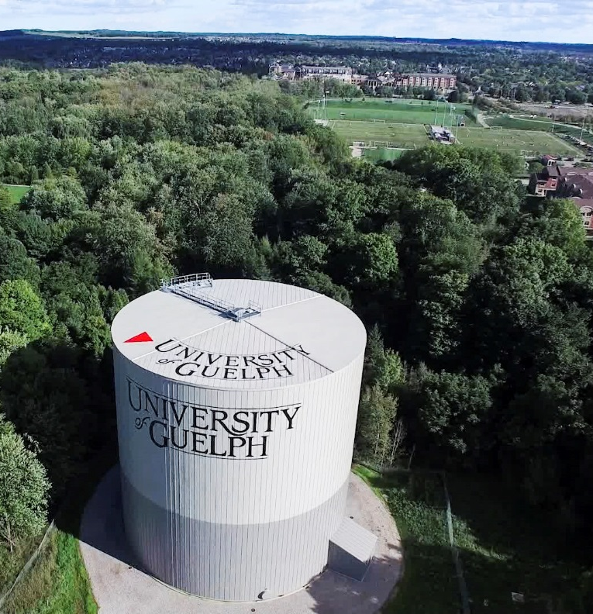
Managing
Demand
Costs
58,000 Ton-hr
CAMPUS THERMAL ENERGY STORAGE SYSTEM
TES Tank Aerial View Summer 2016
Notes:
That is the University’s 58,000 ton-hr thermal energy storage system. Up to 6MW of demand reduction is achieved by shifting chiller production of CHW to nightime – allowing the U to deliver full cooling services during peak daytime loads entirely from the tank storage.

Slide 18
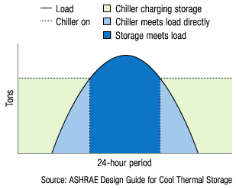
Managing Demand Costs
CAMPUS THERMAL ENERGY STORAGE SYSTEM
Shifting chiller daytime peak demand to off-peak hours
Notes:
So how is the demand reduction achieved?
It is predicated on shifting chiller demand from expensive daytime rates to nightime, and using the TES tank for storage. It’s a thermal battery that get charged at night and discharges during the day. And that cycle repeats itself each day.
Of course there is benefit in choosing the window to charge or discharge– to maximize cost avoidance by keeping chillers off during provincial peak hours. Thankfully the tank has about a 9 hr window for peak summer conditions and this has proved valuable…as anybody in the room from Ontario that is in class A will recognize. he forecast for provincial peaks is just that - a forecast and gaming the hours isn’t easy.

Slide 19
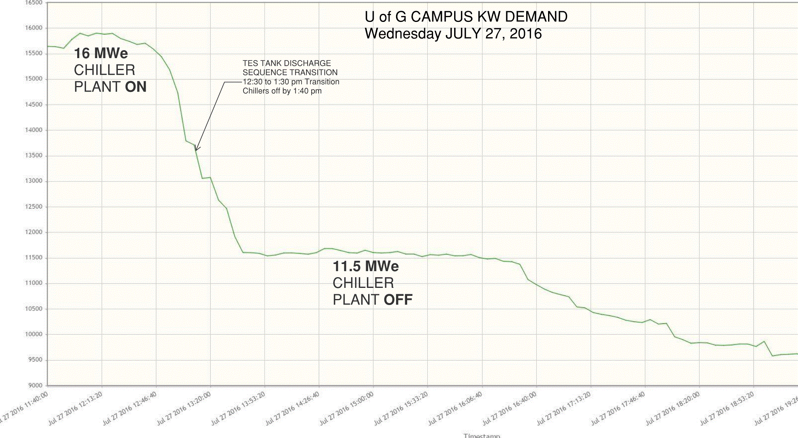
Managing Demand Costs
CAMPUS THERMAL ENERGY STORAGE SYSTEM
Shifting chiller daytime peak demand to off-peak hours

Slide 20
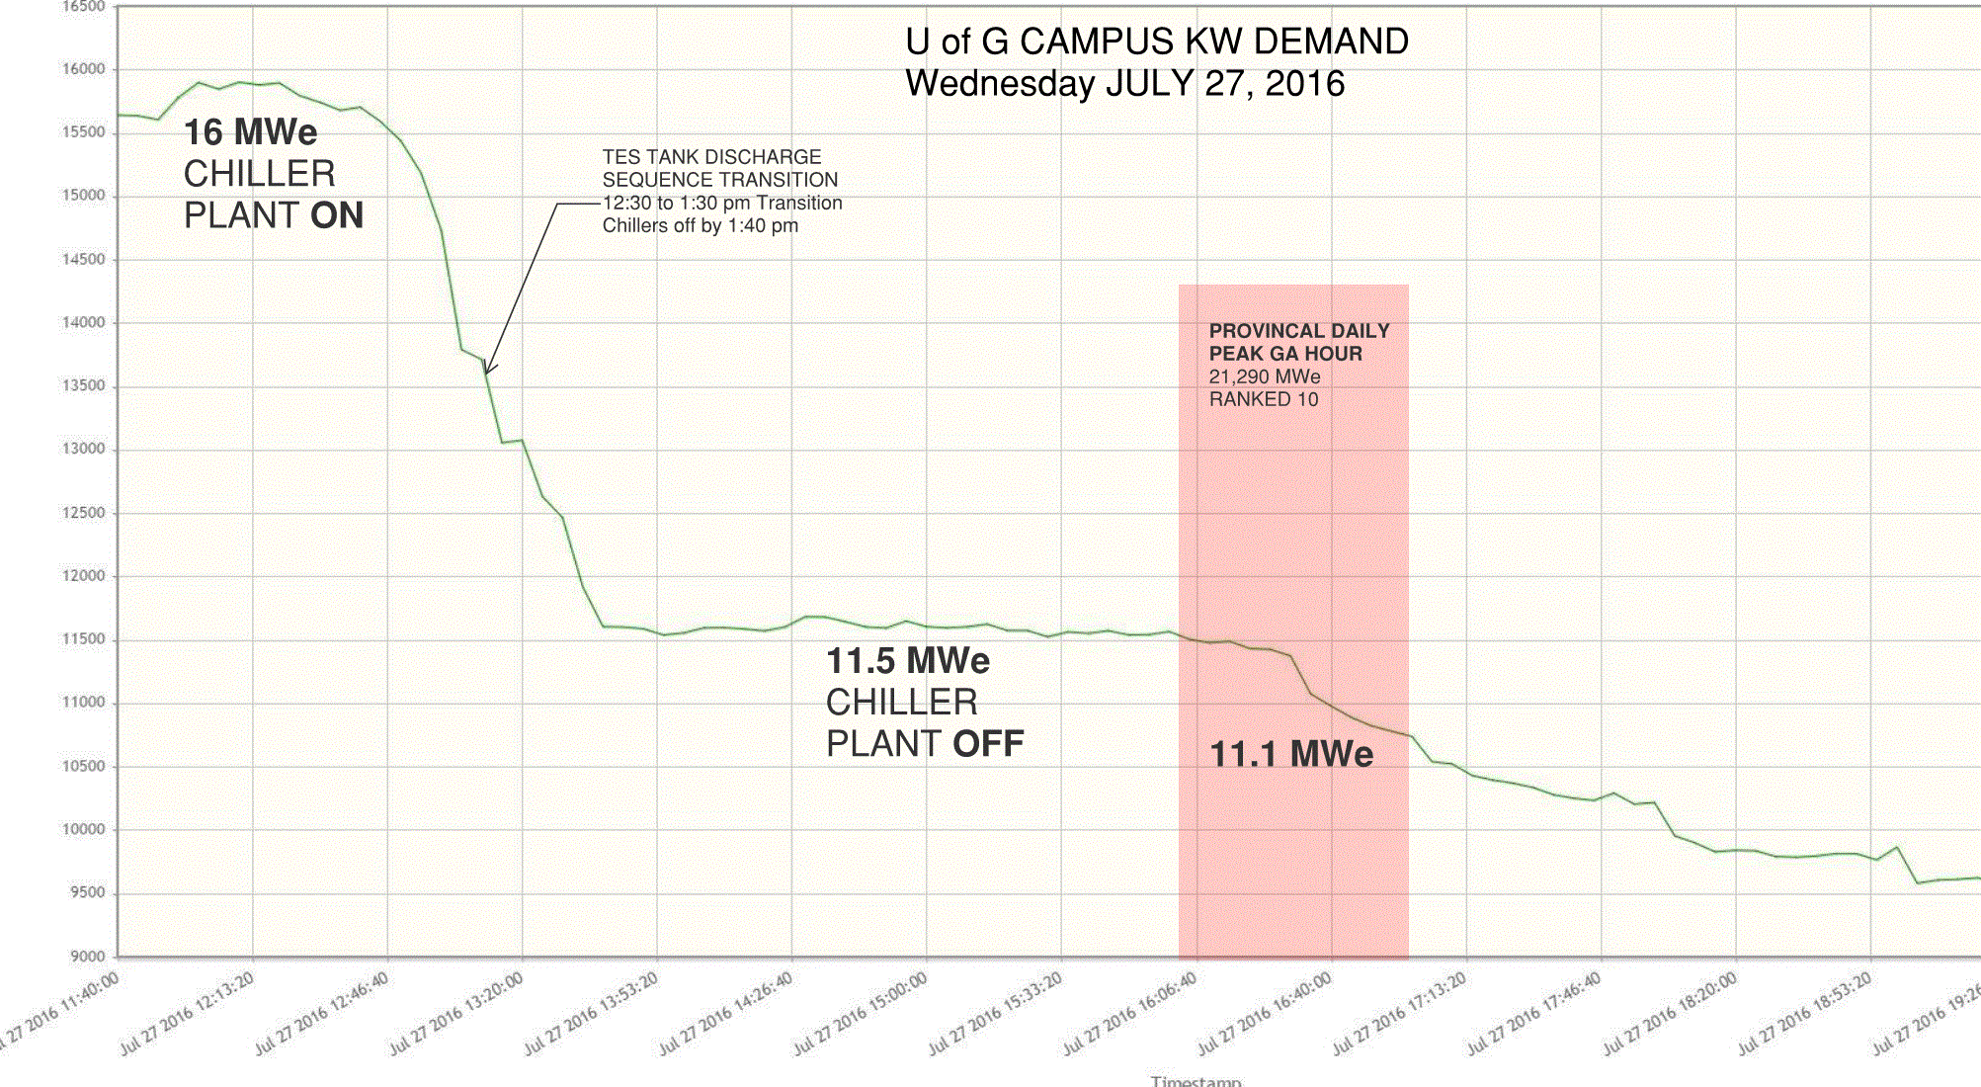
Managing Demand Costs
CAMPUS THERMAL ENERGY STORAGE SYSTEM
Shifting chiller daytime peak demand to off-peak hours

Slide 21
Provincial GA Hours Top 5 |  |  | Ontario Demand | U of Guelph Demand | CHW Load | CUP Demand
 |  |  |  |  |  | Predicted | Actual | Avoided
Rank | Date | Hour | MW | kW | Tons | kW | kW | kW
1 | September 07, 2016 | 17:00 | 23,213 | 11,592 | 5,554 | 4,609 | 833 | 3,776
2 | August 10, 2016 | 18:00 | 23,100 | 9,927 | 4,437 | 3,770 | 716 | 3,054
3 | August 11, 2016 | 17:00 | 22,812 | 10,305 | 5,785 | 4,782 | 758 | 4,024
4 | July 13, 2016 | 18:00 | 22,659 | 9,849 | 5,097 | 4,266 | 716 | 3,550
5 | August 12, 2016 | 17:00 | 22,402 | 10,062 | 5,572 | 4,623 | 714 | 3,909
2016 Performance Results - YTD

Slide 22
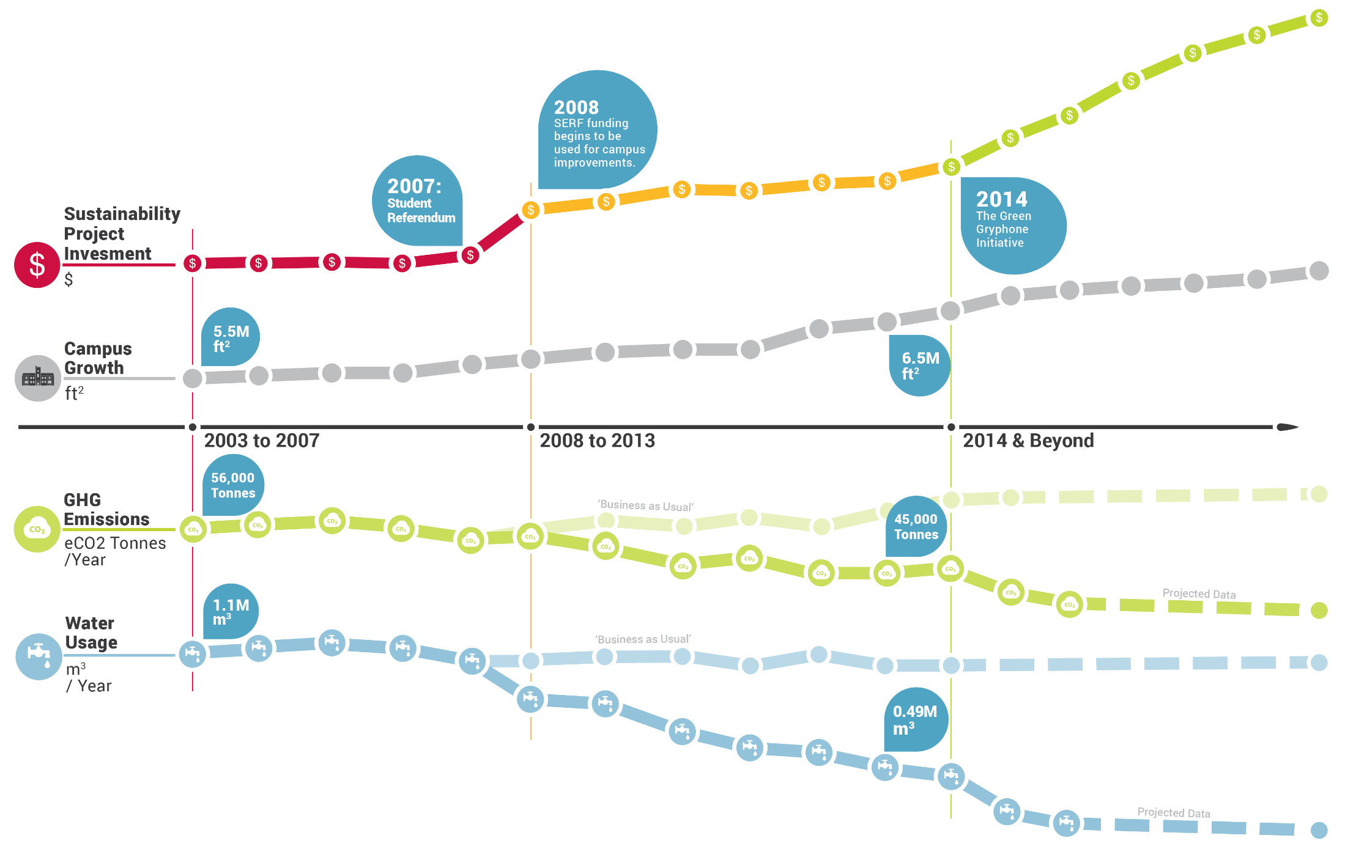
Campus Sustainability

Slide 23
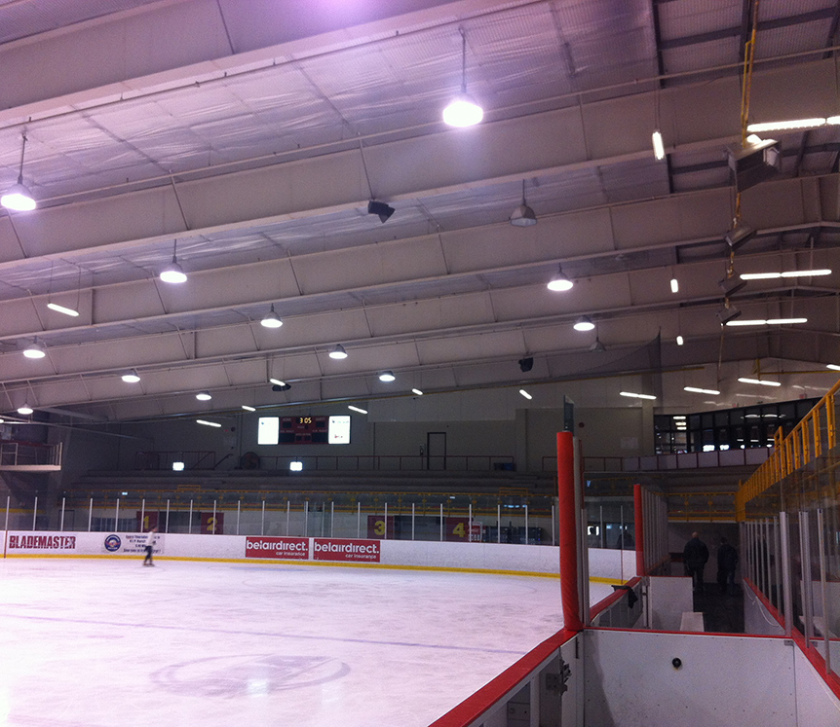
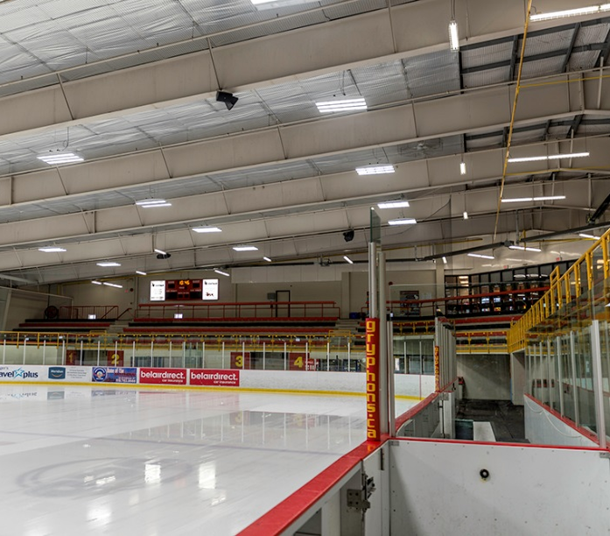
How Are We Doing?
Program Implementation is About ¾ Complete
Starting to Realize Utility Savings and GHG Reductions
Maintenance Able to Redeploy Trade Staff
Improving our facilities
Incentive $$$ are Rolling In!!
before
"The new lighting system is energy efficient, easy to operate and provides our game operators many options to enhance the game experience for our fans and players. All involved have noticed a fantastic improvement in lighting at each level.“
Bill Clausen
Gryphon Centre Facility Manager
after

Slide 24

Program Expected to Achieve Approximately $6,500,000 Incentive $$

Slide 25
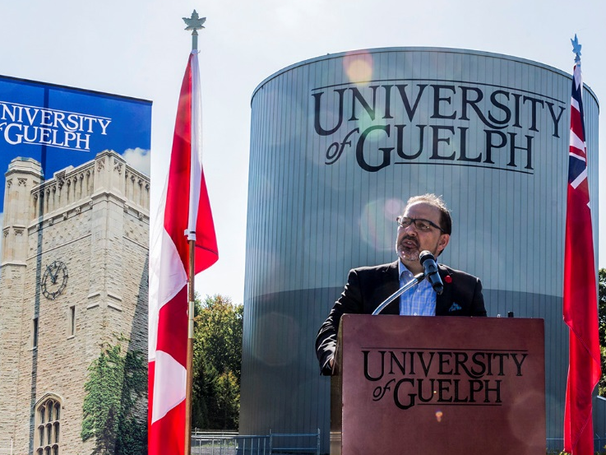
I’m happy to see communities like Guelph celebrating initiatives like this one that will contribute to Ontario’s green energy future.”
Glenn Thibeault
Ontario Minister of Energy

Slide 26
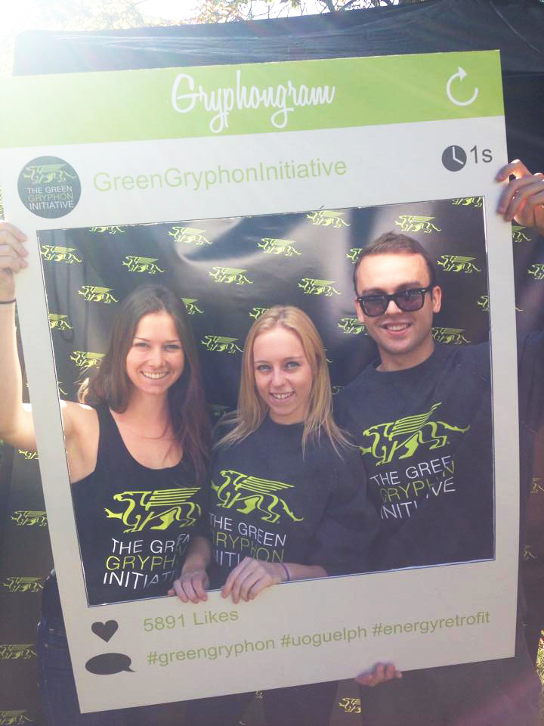
Saving Money
Reducing our Carbon Footprint
Taken a Bite Out of Deferred Maintenance
Improving Our Facilities
Maximized Available Incentive $$$
On Our Way to an 8 Year Payback
Making a Difference!!!

Slide 27






Thank
You!
Project Partners

